Slide 1


BEQ, BNE, J MIPS Operations Lab
Anthony Ramos
CSC342/43
Spring 2021

Slide 2
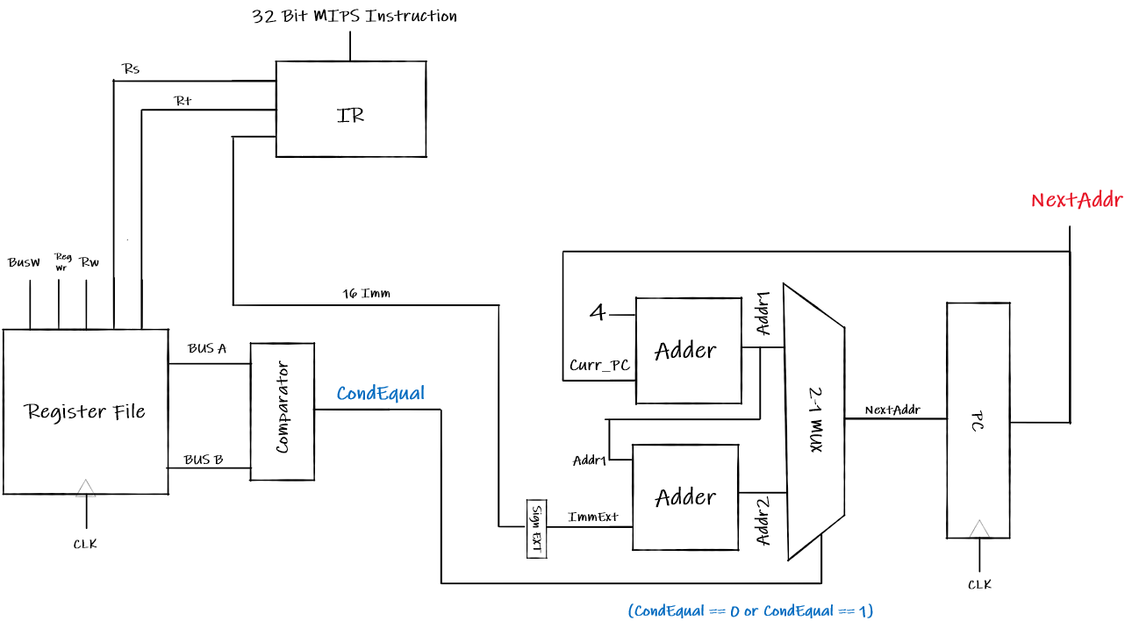

Objective
Implement data paths of BEQ and BNE MIPS instructions to determine the address of the next instruction to be executed. This will be realized using components from previous labs.

Slide 3
I-Type Instruction Format
31 26 21 16 0
OP | Rs | Rt | Immediate
6-Bit 5-Bit 5-Bit 16-Bit

Slide 4
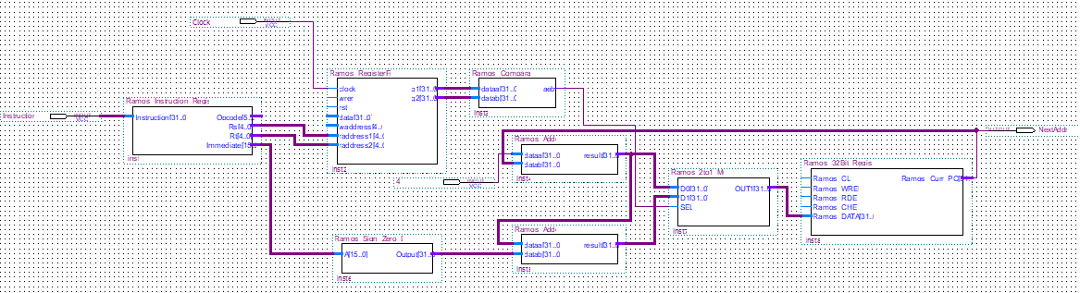
Design (VHDL)

Slide 5
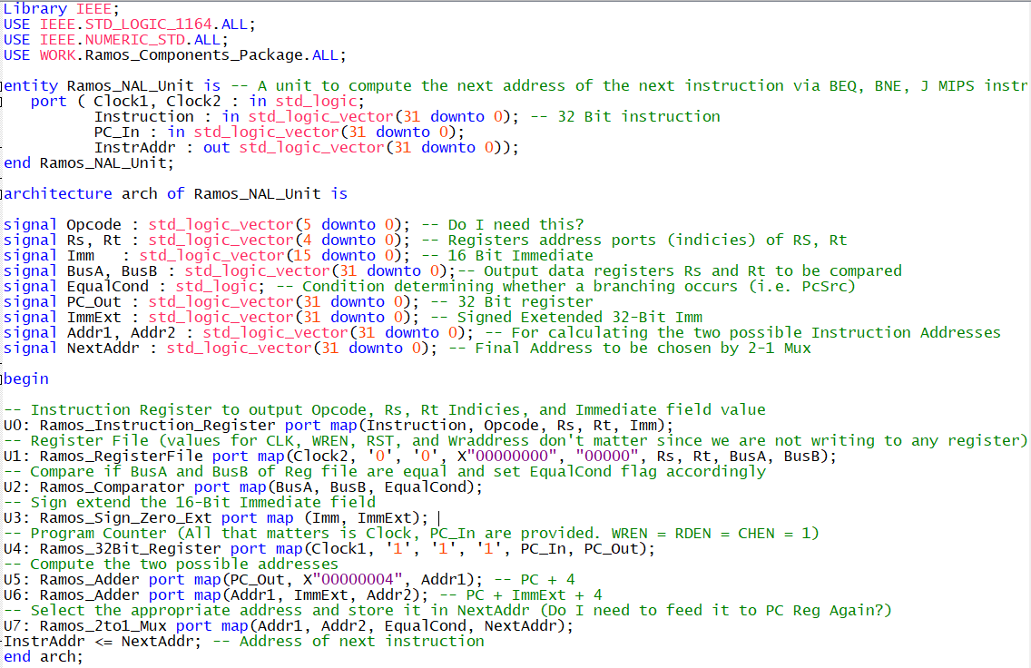
Design (VHDL)

Slide 6
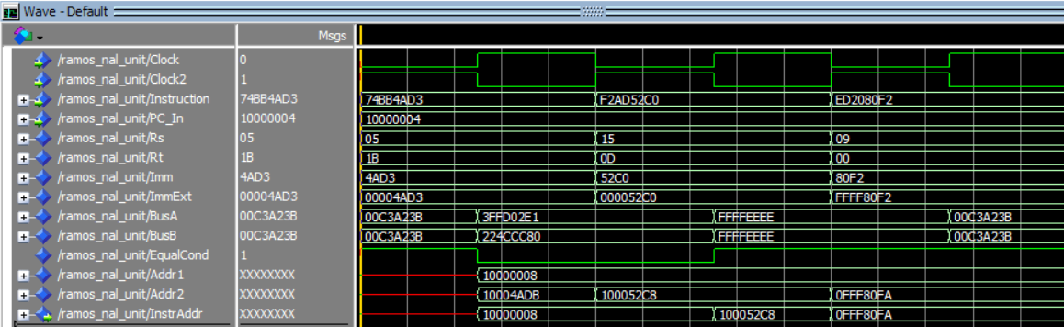
BEQ Simulation
Verification 1
Verification 2
Verification 3

Slide 7
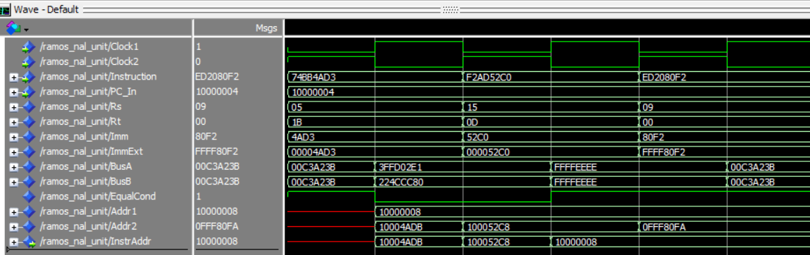
BNE Simulation
Verification 1
Verification 2
Verification 3

